Slide 1



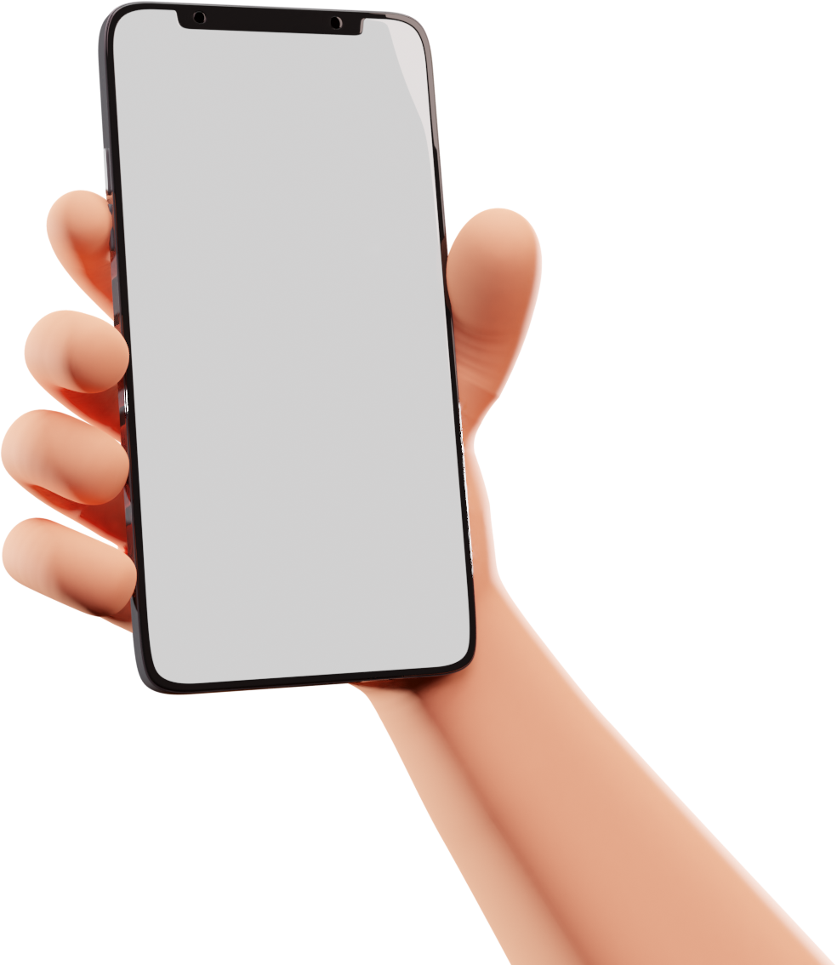
Salford & Co.
MOBILE APPS
PRESENTATION
Presented by Daniel Gallego
www.reallygreatsite.com

Slide 2

Home
About Us
Service
Contact
Wardiere Inc.
Payment App
Wardiere Inc.
Payment App
REVOLUTIONIZING MOBILE PAYMENTS

Slide 3
Wardiere Inc.
Home
About Us
Service
Contact
Payment App
Introduction
Presentations are communication tools that can use as lectures, speeches, reports, and more. It is mostly presented before an audience. It serves a variety of purpose, making presentations powerful
Presentations are communication tools that can use as lectures, speeches, reports, and more
Wardiere Inc.
www.reallygreatsite.com
Payment App

Slide 4
Wardiere Inc.
Home
About Us
Service
Contact
Payment App
Apps Main
Features
1
2
Budget tracking
Expense categorization
Presentations are communication tools that can use as lectures, speeches, reports, and more. It is mostly presented before an audience.
Presentations are communication tools that can use as lectures, speeches, reports, and more. It is mostly presented before an audience.
3
4
Investment insights
Bill reminders
Presentations are communication tools that can use as lectures, speeches, reports, and more. It is mostly presented before an audience.
Presentations are communication tools that can use as lectures, speeches, reports, and more. It is mostly presented before an audience.
Wardiere Inc.
Payment App

Slide 5
Wardiere Inc.
Home
About Us
Service
Contact
Payment App
Market
Overview
Wardiere Inc.
Wardiere Inc.
Payment App
Payment App
Presentations are communication tools that can use as lectures, speeches, reports, and more. It is mostly presented before an audience. It serves a variety of purpose, making presentations powerful
Wardiere Inc.
Payment App
Presentations are communication tools that can use as lectures, speeches, reports, and more
Wardiere Inc.
Payment App

Slide 6
Wardiere Inc.
Home
About Us
Service
Contact
Payment App
Problem
Statement
Problem One
Problem Two
Wardiere Inc.
Problem Three
Payment App

Slide 7
Wardiere Inc.
Home
About Us
Service
Contact
Payment App
Solution
Overview
Solution 1
Presentations are communication tools that can use as lectures, speeches, reports, and more. It is mostly presented before an audience.
Wardiere Inc.
Payment App
Wardiere Inc.
Payment App
Solution 2
Presentations are communication tools that can use as lectures, speeches, reports, and more. It is mostly presented before an audience.

Slide 8
Wardiere Inc.
Home
About Us
Service
Contact
Payment App
User-Friendly
Interface
Presentations are communication tools that can use as lectures, speeches, reports, and more. It is mostly presented before an audience. It serves a variety of purpose, making presentations powerful
Wardiere Inc.
Payment App
Wardiere Inc.
Payment App

Slide 9
Wardiere Inc.
Home
About Us
Service
Contact
Payment App
Benefits
Benefit 1
for Users
Presentations are communication tools that can use as lectures, speeches, reports, and more. It is mostly presented before an audience.
Benefit 2
Presentations are communication tools that can use as lectures, speeches, reports, and more. It is mostly presented before an audience.
Benefit 3
Presentations are communication tools that can use as lectures, speeches, reports, and more. It is mostly presented before an audience.
Wardiere Inc.
Payment App

Slide 10

Wardiere Inc.
Home
About Us
Service
Contact
Payment App
Subscription
Price List
Basic Plan
Standard Plan
Premium Plan
Core features for individual users
Limited transaction volume
Email support
Expanded features for small businesses
Moderate transaction volume
Priority email and chat support
All features, including advanced functionalities
High transaction volume
24/7 priority support with live chat and phone assistance
$25/month
$35/month
$45/month

Slide 11
Wardiere Inc.
Home
About Us
Service
Contact
Payment App
How to
Subscribe
1. Visit our website or mobile app
2. Choose your desired plan.
Wardiere Inc.
Wardiere Inc.
Payment App
Wardiere Inc.
Payment App
Payment App
3. Enter payment details.

Slide 12

Wardiere Inc.
Home
About Us
Service
Contact
Payment App
Customer
Testimonial
Samantha Rachel
"I've been using wardiere inc for my small business, and it's been a game-changer. The convenience and efficiency it brings to my day-to-day transactions are remarkable. The user-friendly interface made it easy for me to manage payments, and the security features put my mind at ease.
Wardiere Inc.
Payment App

Slide 13
Wardiere Inc.
Home
About Us
Service
Contact
Payment App
Download
Now!
www.reallygreatsite.com
Wardiere Inc.
Payment App

